Slide 1

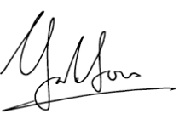
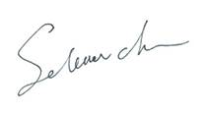
特授此证予
Present to
With grateful heart, we appreciate your dedication and efforts to #PullingOurWeight ocean cleanup event. Your commitment and action make the ocean cleaner and healthier.
感谢您参加清洁海岸线志愿者活动，您的努力让大海更洁净。
Yoke Loon Lim
Greater China President
Selena Chu
APAC IS/CF Director
Chair of SDC Site Leadership Team
Sep 22nd , 2019

